Slide 1
Genotype and related terms

Slide 2
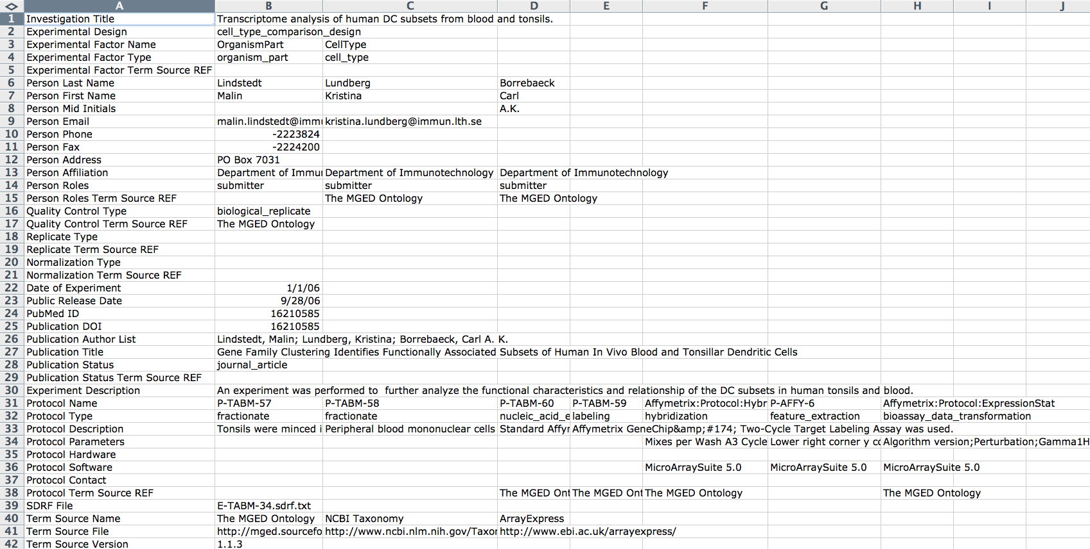
IDF file for E-TABM-34
IDF = Investigation Description Format
Notes:
Not only who did it, but what was their objective and what procedures did they use. Uses controlled vocabularies to facilitate searches

Slide 3
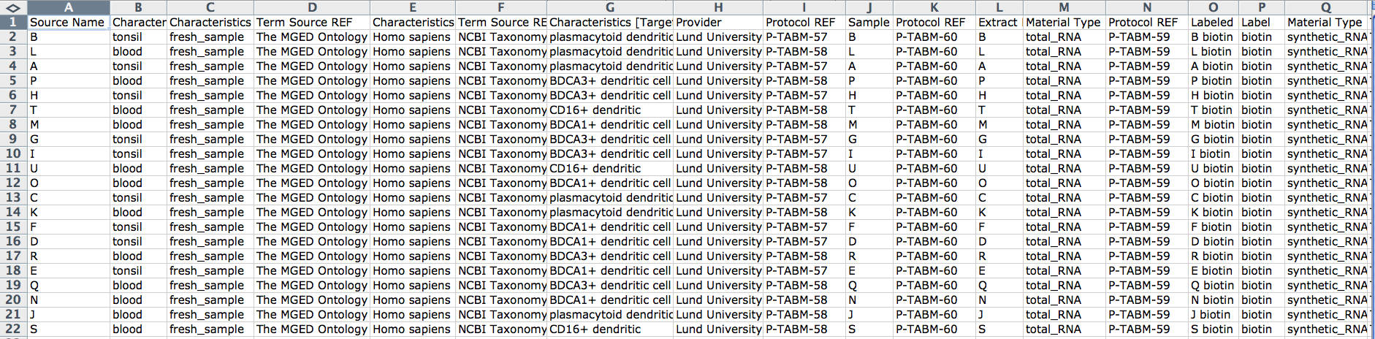
SDRF file for E-TABM-34
SDRF = Sample and Data Relationship Format
Notes:
Each row represents a sample and what was done with it.

Slide 4
Terms are needed for annotation of functional genomics data
The values users used to specify genotype:

Slide 5
Terms are needed for annotation of functional genomics data
Most are
allele information
genetic transformation
Wild type need:
Genotype wild type
Allele wild type

Slide 6
In Sequence Ontology
variant_collection:
A collection of one or more sequences of an individual.
Equivalent Class:
sequence_collection AND
has_part SOME sequence_alteration
subclasses
genotype: A genotype is a variant genome, complete or incomplete.
allele: An allele is one of a set of coexisting sequence variants of a gene.
haplotype: A haplotype is one of a set of coexisting sequence variants of a haplotype block.
chromosome_variation:

Slide 7
MIREOT from SO?
Import genotype and related terms from SO
Proposed by Jie and Chris at beginning
Reasons:
happy with variant_collection definition
tricky terms, not in OBI scope
First discussed on Nov 29, 2010 dev call
Issue with SO definition for genotype.
Alan proposed that OBI have “genotype information” while we wait for SO to address the definitions

Slide 8
Current Status
We have discussed two terms:
genotype information
genetic material
(https://obi.svn.sourceforge.net/svnroot/obi/trunk/src/ontology/branches/ExpDesign.owl)
Have debates on both terms

Slide 9
OBI: genotype information (1)
Definition: a data item (individual genetic characteristics information) that is about the genetic material of an organism and minimally includes information about the genetic background and can in addition contain information about specific alleles, genetic modifications, etc.
'genetic characteristics information'
and (('is about' some region)
and (is_concretized_as some ('inheres in' some
('genetic material' and (part_of some organism)))))
this axiom is provided by Alan, added after Nov 29, 2010 OBI call
(has_part some 'allele information')
and (has_part some 'genetic background information')
this axiom added on Feb 28, 2011 OBI call, proposed by Bjoern, agreed by attendees (Alan is not on the call)

Slide 10
OBI: genotype information (2)
Most people are happy with current definition
Alan:
Don't think that the inclusion of background is essential. Counterexample: http://www.entrogen.com/web/cyp2c9-vkorc1-genotyping-reagents-warfarin-sensitivity.php
Having the requirement for background in the *datum* is not necessary, however desirable.
Matthew Brush (eagle-i):
My question is whether the notion of 'genotype information' covers all transmissible genetic material (which would include inserted extrachromosomal genetic material), or only material inherited from an immediate ancestor. I would be inclined to think the latter.

Slide 11
Organism
Mus musculus
Strain
C57/B6
Genotype information: a data item (individual genetic characteristics information) that is about the genetic material of an organism and minimally includes information about the genetic background and can in addition contain information about specific alleles, genetic modifications, etc.
'genetic characteristics information’ and (('is about' some region) and (is_concretized_as some ('inheres in' some ('genetic material' and (part_of some organism)))))(has_part some 'genetic background information')
Wild type organism genotype information
representative individual from a class of organisms
Inbred organism
Mus musculus wild type
C57/B6 wild type:
B6x129
B6 Hnf1a+/-
Genetic background information
Human
B6
Allele information: about some region and is part of genotype information. Is a genetic characteristics information
Wild type allele
Hnf1a +/ A36M
HLA A0201+
Hnf1a wild type

Slide 12
Genotype information: a data item (individual genetic characteristics information) that is about the genetic material of an organism and minimally includes information about the genetic background and can in addition contain information about specific alleles, genetic modifications, etc. relative to that background (i.e., genetic alteration information).
'genetic characteristics information’ and (('is about' some region) and (is_concretized_as some ('inheres in' some (’nucleic acid molecule' and (part_of some organism)))))(has_part some 'genetic background information')
Wild type organism genotype information
Is a genotype information about an organism and includes information that there are no known modifications to the genetic background.
representative individual from a class of organisms
Inbred organism
Output of a genotyping assay.
Genetic alteration information: known changes or the lack thereof from the genetic background
Allele information
Duplication, insertion, etc.
Genetic population background information: a genetic characteristics information which is a part of genotype information that identifies the population of organisms
Organism information part of genotype information
Human
B6

Slide 13
OBI: genetic material (1)
Definition: A nucleic acid macromolecule that is part of an organism and can be replicated within it.
'nucleic acid' and (part_of some organism)

Slide 14
OBI: genetic material (2) -> gone for now: replaced with nucleic acid molecule/ nucleic acid extract
Debates on its textual definition
Alan: By this definition virions don't have genetic material.
Bjoern proposed new definition:
genetic material: A nucleic acid macromolecule that is part of an organism and is either derived from an immediate ancestor or inserted in a manner that it will be replicated and integrated into immediate ancestors.
Alan suggested:
replace ‘inserted’ with ‘incorporated’ (inserted sounds intentional)
replace ‘will be replicated and integrated into immediate ancestors’ with ‘has the disposition to be replicated in descendants’
Marcus: cutting the last two words ("within it") will solve the problem of viral genetic material.
Input to a genotyping assay via a specimen or organism. Genetic material specimen has part nucleic acid molecule. Contains genetic material
Issue with “is part” – what about genetic material from a specimen?

Slide 15
Blood sample from human and genotyped for APOE-4
Blood specimen and sample from organism
Nucleic acid extract from blood specimen
Genotyping assay
Genotype information: APOE-4
output of genotyping assay
part “Homo sapiens” genetic background information
part “APOE-4” genetic alteration information

